Slide 1
Processor Customization Using TCE Quick Walkthrough Screencast
By Aleksi Tervo and
Pekka Jääskeläinen of
Customized Parallel Computing group ,
Tampere University of Technology, Finland
http://cpc.cs.tut.fi
Updated on 2018-06-27

Slide 2
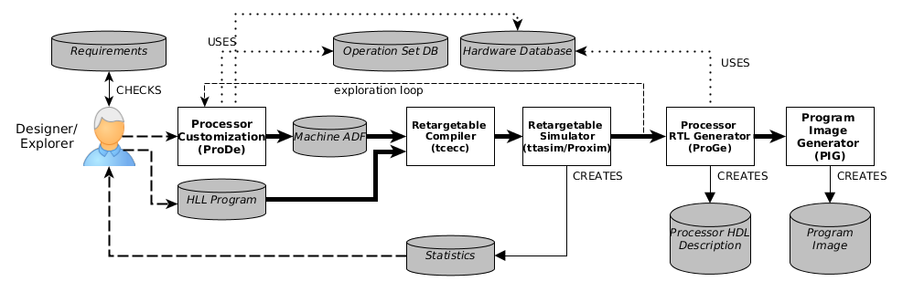
Defining the Application Source Code

Slide 3
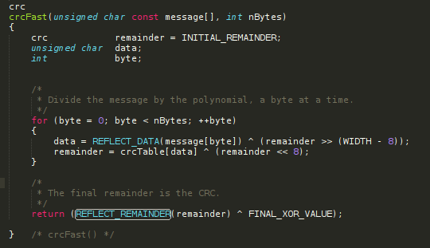
Example App: CRC32 Checksum
Notes:
Basic Cyclic Redundancy Check application
Used to calculate CRC-32 for a short 10-character string

Slide 4
Defining a Starting Point Architecture

Slide 5
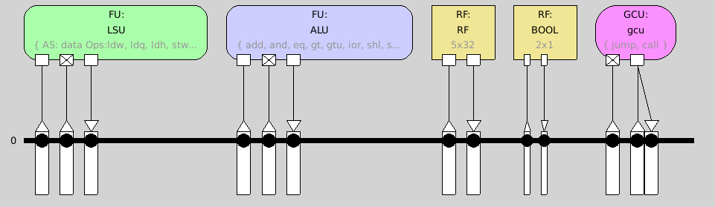
Let’s Start with a Minimal TTA Supported by the TCE Compiler
Notes:
Minimal architecture: one LSU, one simple ALU, 5 registers

Slide 6
Compilation and Instruction-Set Simulation

Slide 7
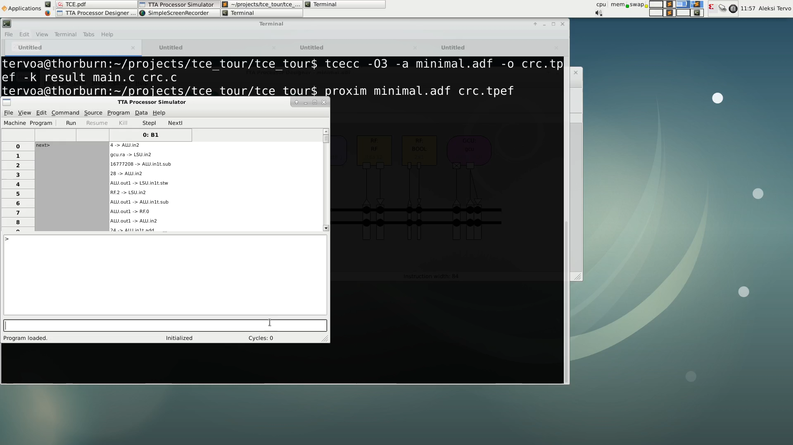
Simulation
Notes:
12s

Slide 8
Identifying the Bottlenecks
Starting point instruction cycles: 2315

Slide 9
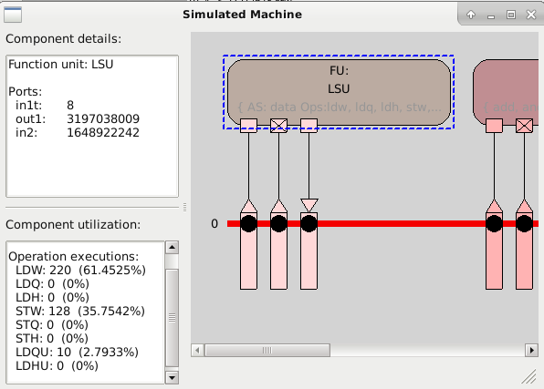
Locating Bottlenecks
Notes:
Simulation shows us LSU is seeing high utilization
Caused by register file spilling
→ Increase RF size

Slide 10
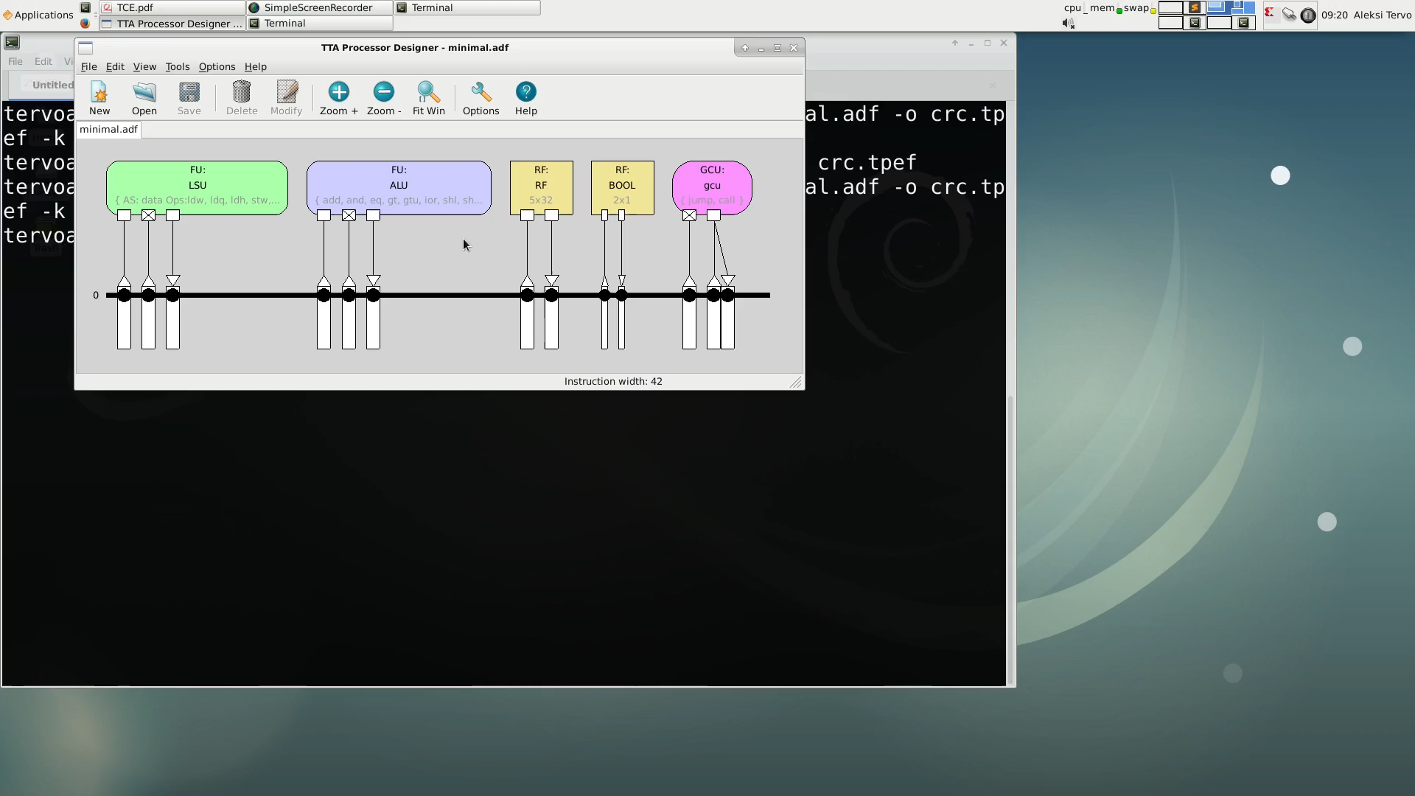
Adding Registers to Reduce Spills
Notes:
Simulation shows us LSU is seeing high utilization
Caused by register file spilling
Increase RF size

Slide 11
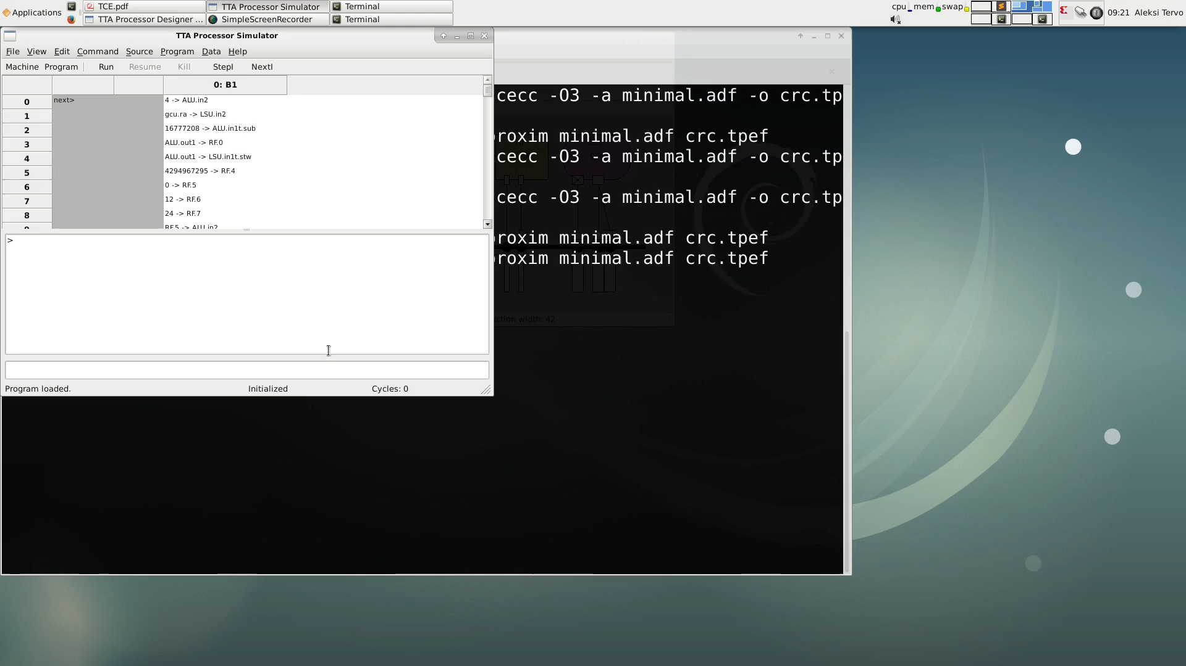
Simulation
Notes:
Memory operations significantly cut
Cycle count from 2315 to 990 -> 58% decrease

Slide 12
Interconnect network
Current cycle count is 990 (down from 2315)
Currently, the machine only has one bus
Moving the data to start an ALU operation takes two cycles!
Adding a second bus should increase performance considerably

Slide 13

Adding a Second Bus
Notes:
6s

Slide 14
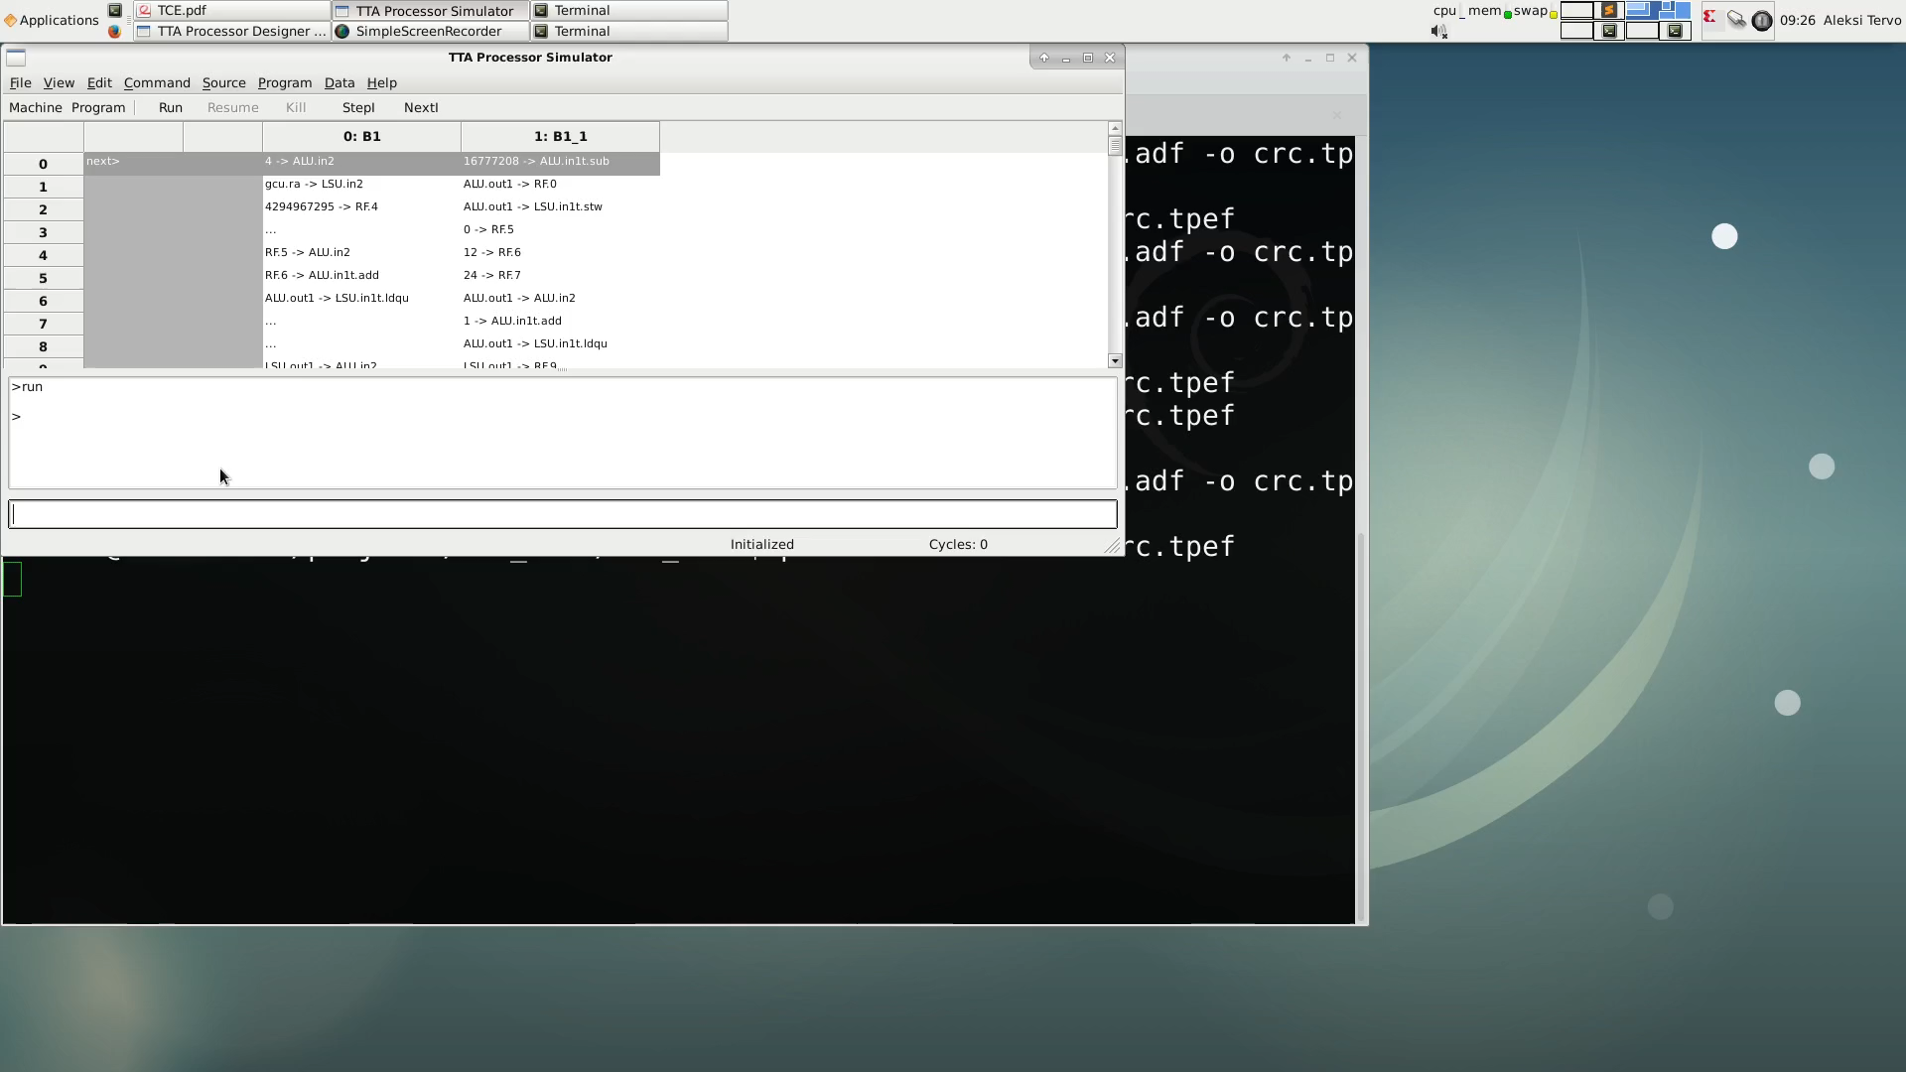
Simulation
Cycle count from 990 to 581 -> 42% decrease from previous architecture
Notes:
Cycle count from 990 to 581 -> 42% decrease from previous architecture.

Slide 15
Adding a Custom Operation
Current instruction cycles: 581

Slide 16
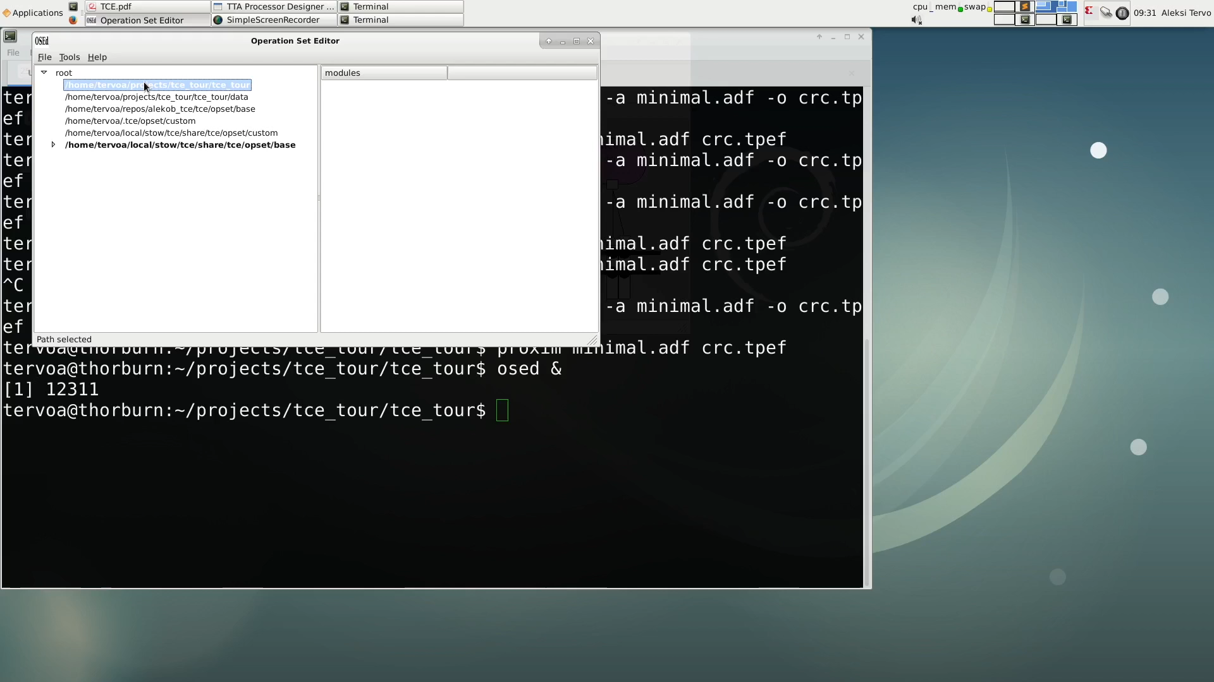
Add an Operation Semantics Definition with Operation Set Editor
Notes:
17s

Slide 17
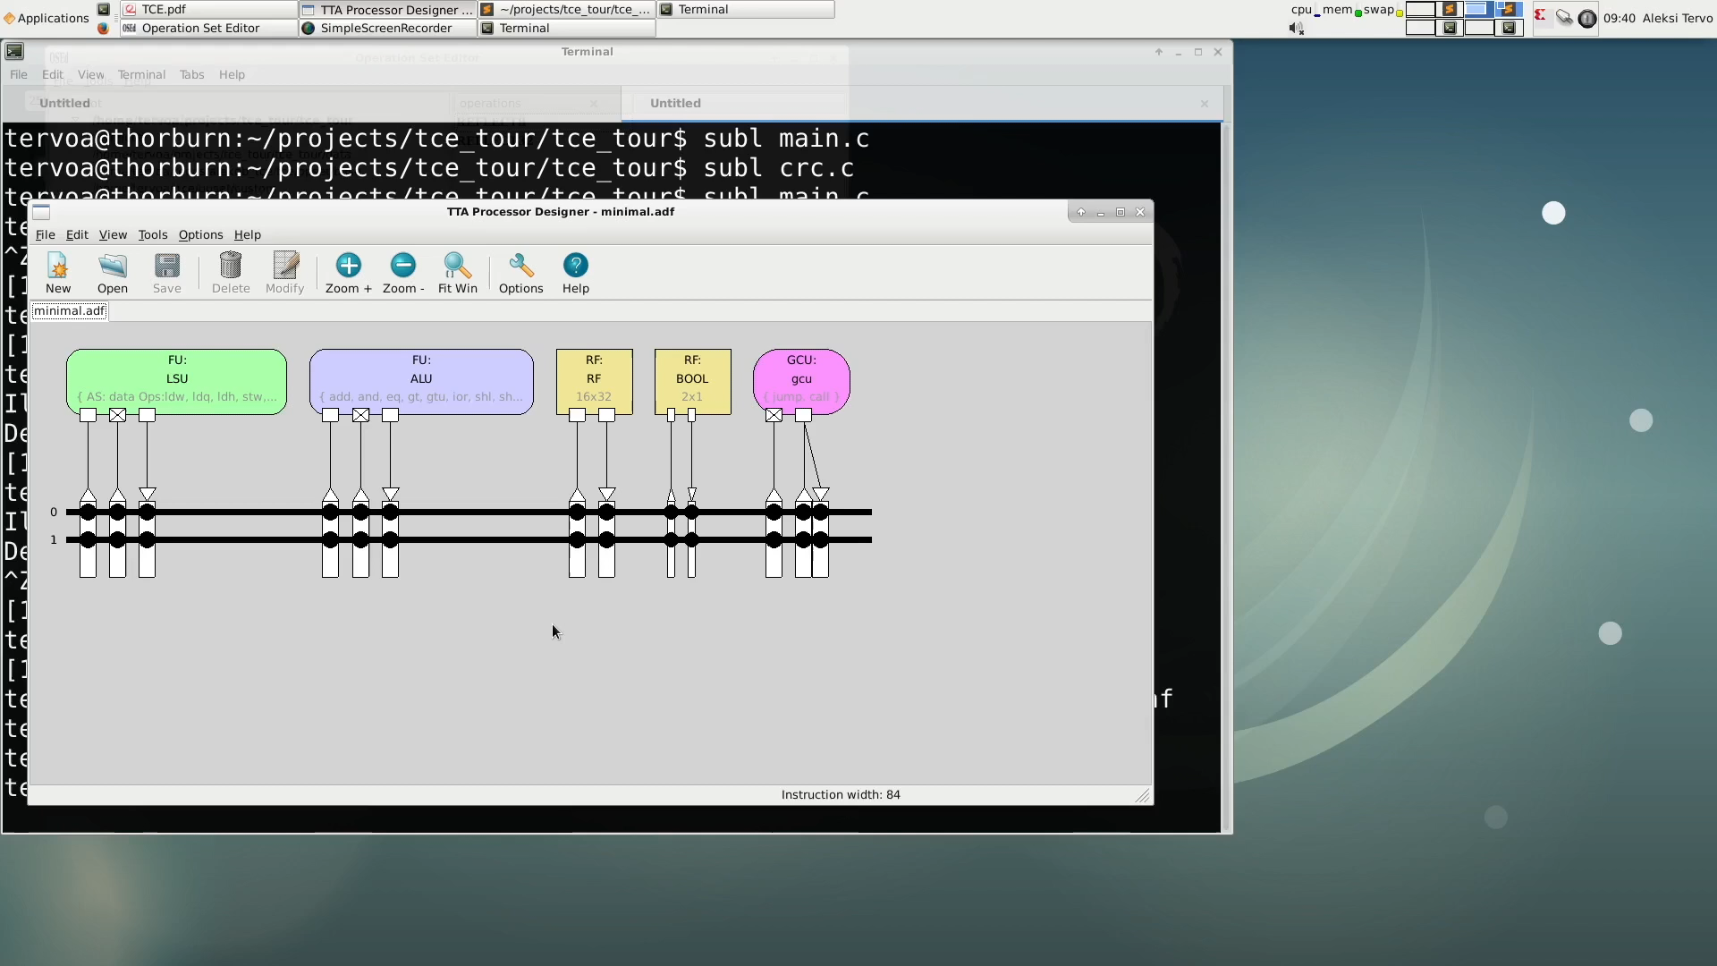
Add a Function Unit with the Custom Operation to the Architecture
Notes:
31s

Slide 18
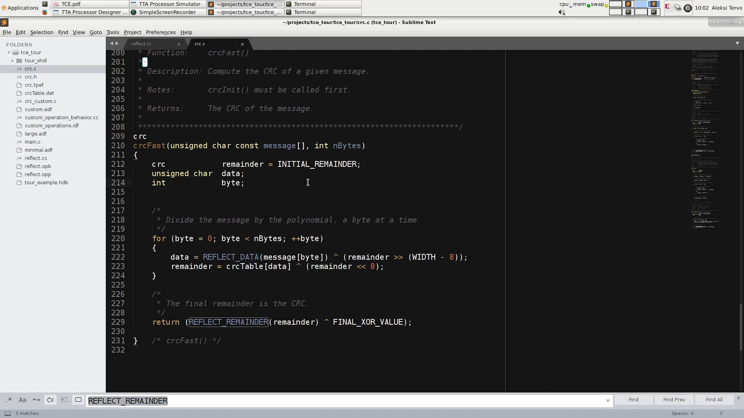
Modify Code to Call the Complex Custom Operation via Autogenerated Intrinsics

Slide 19
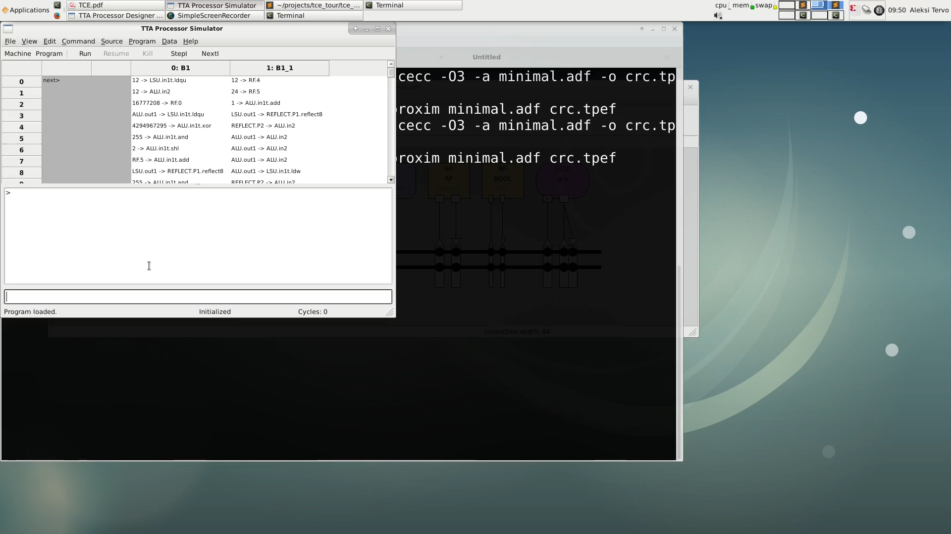
Simulation
Cycle count from 581 to 139 -> 77% decrease
Notes:
Simulation supports custom operation -> can verify code correctness from result
Cycle count from 581 to 139 -> 77% decrease
Final cycle count is 1/16 of original

Slide 20
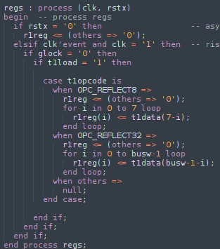
RTL Implementation
Notes:
In order to generate a processor, we need to describe the custom FU we added in RTL
(There’s some automation availabel for simple FUs)
Main logic of the function unit is very simple:
When processor is running and operation is loaded,
Write result of selected operation to output register

Slide 21
Add a Function Unit Implementation to a Hardware Database

Slide 22
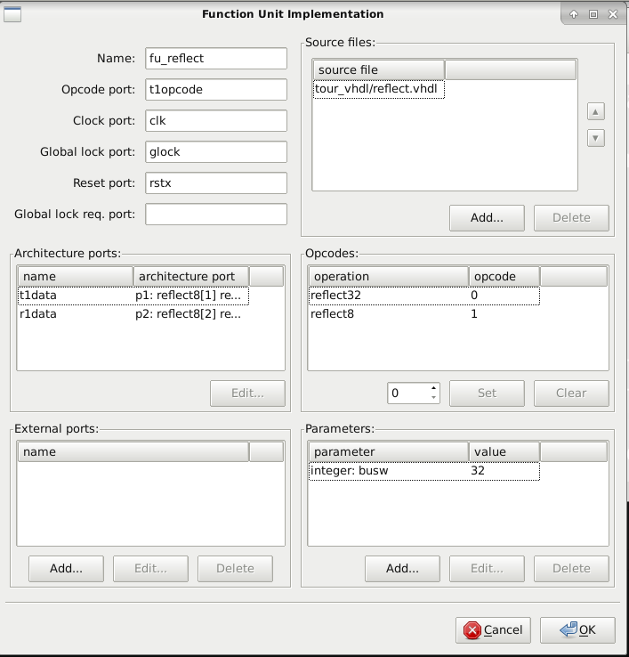
Add FU to HDB
Notes:
Specify FU in hdbeditor:
Port names, generics, RTL files and compilation order i.e. the info required to instantiate the component

Slide 23
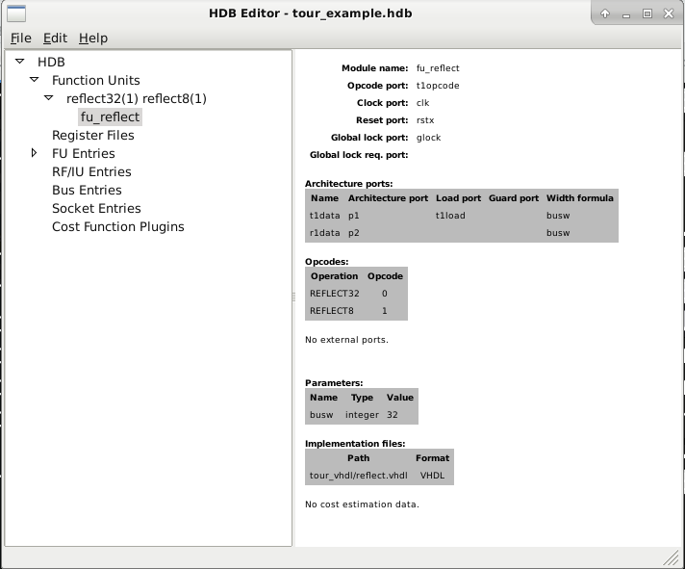
Add FU to HDB
Notes:
Resulting database entry

Slide 24
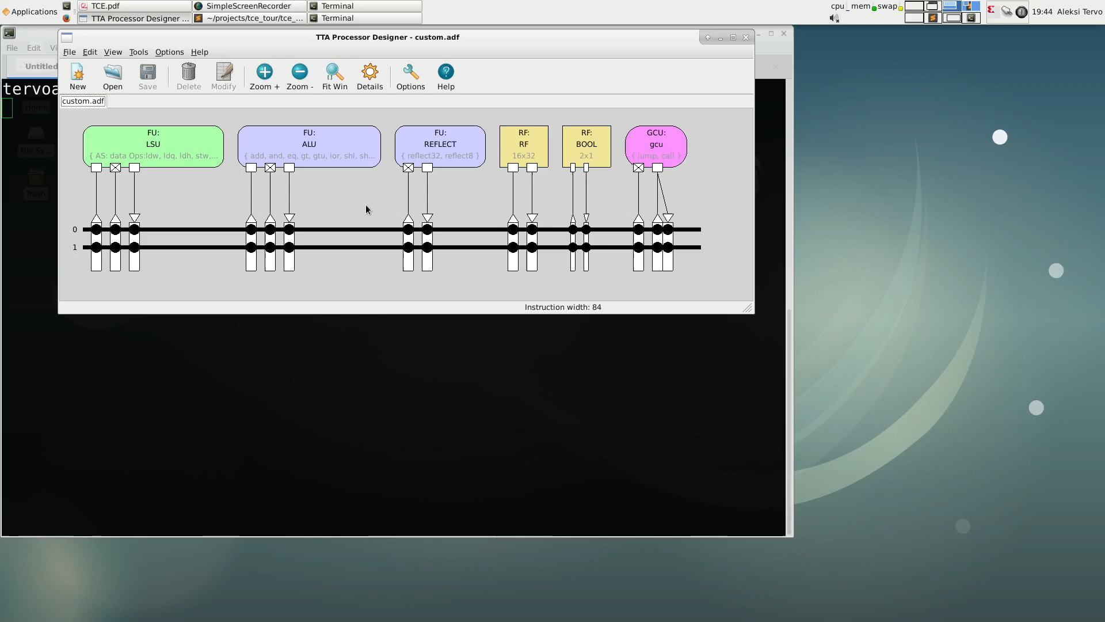
Select Implementations for Architecture Components
Notes:
Select implementations from the default HDB and the one containing custom FU

Slide 25
Generating the VHDL or Verilog RTL

Slide 26
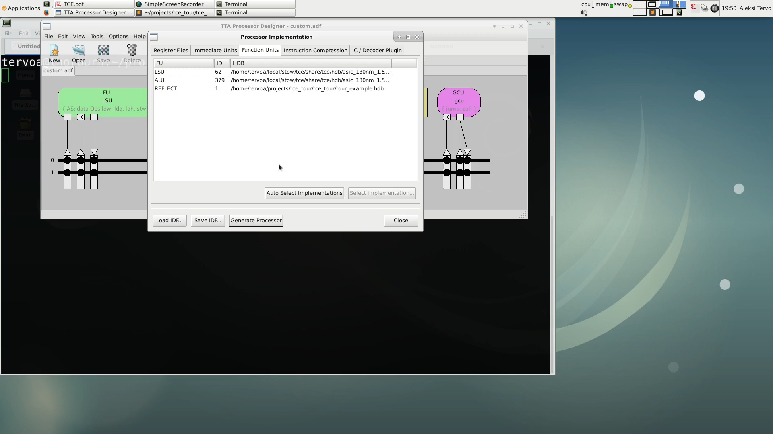
Finally: Generate the RTL
Notes:
All that’s left to do for a working core is to connect memories to the core interfaces
There are automatic integrators for FPGAs

